Slide 1
Student Details
Name :Riswal Anil Sukhlal
SkillBuild Email ID :anilriswal2017@gmail.Com
College name: CSMSS Chh Shahu College Of Engineering Kanchawadi Chh Sambhajinagar
College State: Maharashtra
Internship Domain : Artificial Intelligence

Slide 2
PROJECT TITLE/Problem Statement
Mental Health Tracker
In today's world, stress and anxiety have become very common, which can have a negative impact on our cognitive abilities. To tackle this issue, the Mental Fitness Tracker has been introduced. It is a tool that can help individuals measure, track, and enhance their cognitive resilience. This model provides a mental fitness and its benefits

Slide 3
AGENDA
PROJECT OVERVIEW
WHO ARE THE END USERS of this project?
SOLUTION AND ITS VALUE PROPOSITION.
Customization of the project.
Modelling.
Results.

Slide 4
PROJECT OVERVIEW
Purpose: The purpose of this project is to develop a comprehensive and user-friendly mental fitness tracker that empowers individuals to monitor, assess, and improve their mental well-being effectively. The project aims to promote self-awareness, early detection of mental health issues, and the adoption of healthy coping mechanisms, contributing to better overall mental health and a higher quality of life for users.
Scope: Develop a user-friendly mental fitness tracker with mood tracking, stress assessment, guided meditation, cognitive exercises, wearable device integration, data visualization, and strong emphasis on user privacy.
The scope of this project includes: Mood Tracking and Analysis, Stress Level Assessment, Meditation and Mindfulness Guidance, Cognitive Exercises and Brain Training, Integration with Wearable Devices, Data Visualization

Slide 5
WHO ARE THE END USERS of this project?
General Users: People from all walks of life who want to track and manage their mood, stress levels, and emotional well-being to lead a healthier and more balanced life.
Stress Management Seekers: Individuals dealing with stress-related issues, such as work-related stress, academic stress, or personal challenges, who wish to find effective ways to manage and reduce their stress levels.
Meditation and Mindfulness Practitioners: Individuals interested in incorporating meditation and mindfulness practices into their daily routine to improve focus, relaxation, and emotional stability.
Cognitive Enhancement Enthusiasts: People looking to boost their cognitive abilities, memory, and mental agility through interactive cognitive exercises and brain training activities.
Mental Health Conscious Individuals: Individuals who are proactive about their mental health and want to stay informed about their emotional well-being to detect early signs of potential mental health issues.
Fitness and Wellness Enthusiasts: Individuals who prioritize overall well-being and are interested in integrating mental fitness tracking alongside their physical fitness tracking to achieve holistic health goals.

Slide 6
YOUR SOLUTION AND ITS VALUE PROPOSITION
Solution: The Mental Fitness Tracker utilizes advanced machine learning algorithms to comprehensively track and analyse the prevalence and impact of various mental health disorders, including Schizophrenia, Bipolar Disorder, Eating Disorder, Anxiety, Drug Usage, Depression, and Alcohol-related issues. By offering data-driven insights and personalized support, this innovative tool aims to foster holistic mental wellness and enable early detection of potential challenges in these mental health domains.
Value Proposition: The Mental Fitness Tracker is a cutting-edge solution that empowers individuals to proactively prioritize their mental health by providing personalized guidance for holistic well-being. By seamlessly integrating physical and mental health data, the tracker facilitates early detection of potential issues, enabling timely intervention and support. Rest assured, user privacy is of utmost importance, ensuring a secure and confidential experience. Embrace the Mental Fitness Tracker for a healthier, balanced life, where mental well-being takes center stage.

Slide 7
How did you customize the project and make it your own
Personalization and AI-driven Insights: Implement advanced artificial intelligence algorithms to provide personalized recommendations, insights, and mental health assessments based on individual user data. This AI-driven approach can adapt to each user's unique needs, making the tracker highly innovative and effective.

Slide 8
MODELLING
For the building of a machine learning model, I have trained on two models: "LINEAR REGRESSION" And "RANDOM FOREST regression," respectively. The random forest regression works well on both datasets as well as testing, where the MSE is 0.0048, the RMSE is 0.069, and the R2 score is 0.99.
Here brief about Random forest: Random Forest Regressor is a powerful machine learning algorithm used for regression tasks. It combines multiple decision trees to create a robust and accurate prediction model. With its ability to handle non-linearity, feature importance ranking, and reduced overfitting, it is widely applied in predictive analytics, recommender systems, risk assessment, and more. The algorithm's versatility and high accuracy make it a valuable tool for various industries seeking reliable predictions.
Key Features:
Ensemble Learning
Feature Importance
Reduced Overfitting
Handling Non-linearity

Slide 9
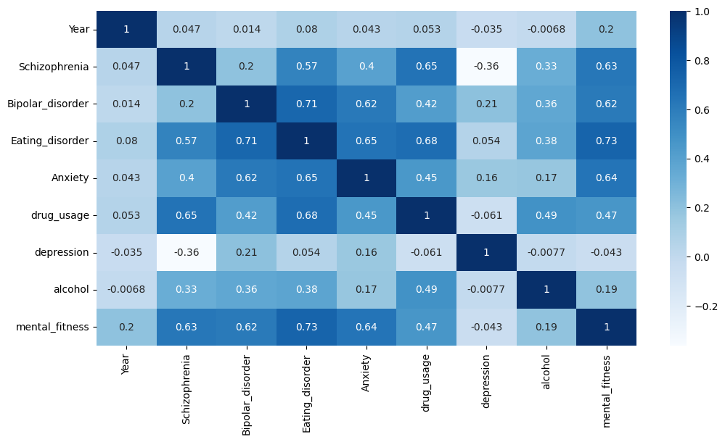
EXPLORATORY ANALYSIS
numeric_columns = ['Year','Schizophrenia', 'Bipolar_disorder', 'Eating_disorder', 'Anxiety', 'drug_usage', 'depression', 'alcohol', 'mental_fitness']
numeric_data = data[numeric_columns]
plt.figure(figsize=(12, 6))
sns.heatmap(numeric_data.corr(), annot=True, cmap='Blues')
plt.show()
This code performs a correlation analysis between numeric columns in a given dataset and visualizes the results using a heatmap. It uses Python's seaborn and matplotlib libraries for data visualization.

Slide 10
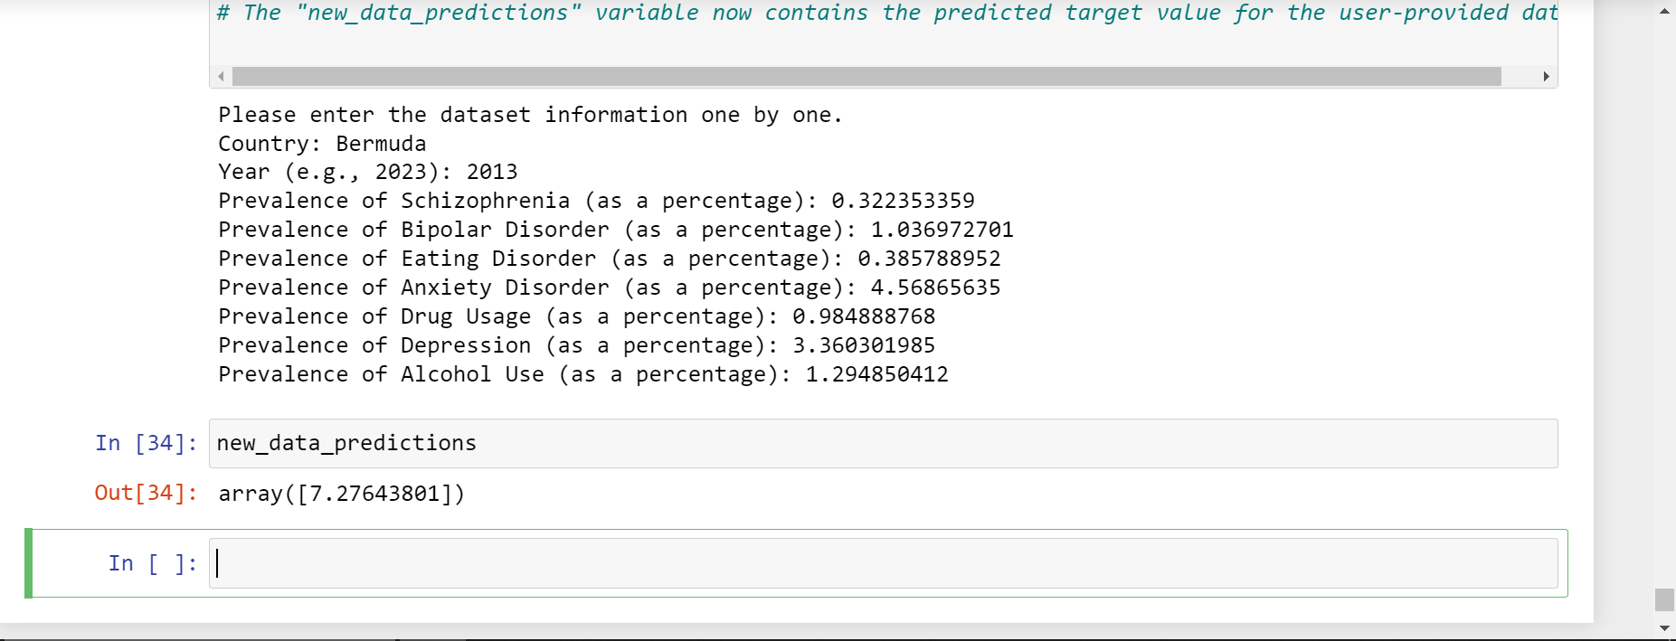
Results
as shown in the image there is average of 7.27643801 base on given new data to predicate

